Slide 1

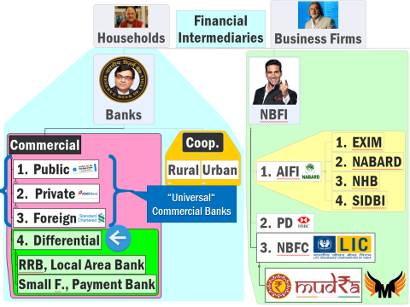
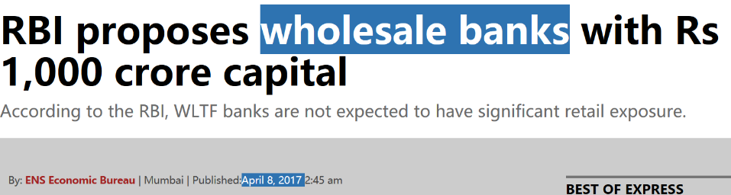
Commercial Banks →Differential Banks (Chronological order)
RRB [1976]
LAB [1996]
Small Finance Banks Payment Banks [2015]
Wholesale Bank (Proposed)

Slide 2



Infrastructure Finance: how to increase in absolute figure?
Fiscal Deficit ☹
NPA problem ☹

Slide 3



Timeline: Wholesale and long-term finance (WLTF) BANK
2014
2017, April
Nachiket Mor Committee proposed
2016, April
M.policy mentioned
Discussion Paper

Slide 4


Wholesale and long-term finance (WLTF) BANK: functions
Deposit?
Bonds
Wholesale bank
Lending?
Infra projects.
Bank Borrowing
Savings Account
Current Account
Fixed / Term deposits (>10cr.)
Small, medium, corporate business.
Help PSL-targets for Banks. <PSL-Certificate (Lecture LINK) >

Slide 5



Bank
uSCB
WLTF
Capital Cr.
500
100
Deposit
All types
CASA| FDRD
All types
PB: 1 lakh
PB|SFB
1000
CA|FD>10 cr.
Lending
40%PSL
SFB:75% PB: 0%
Only large infra & corporate

Slide 6
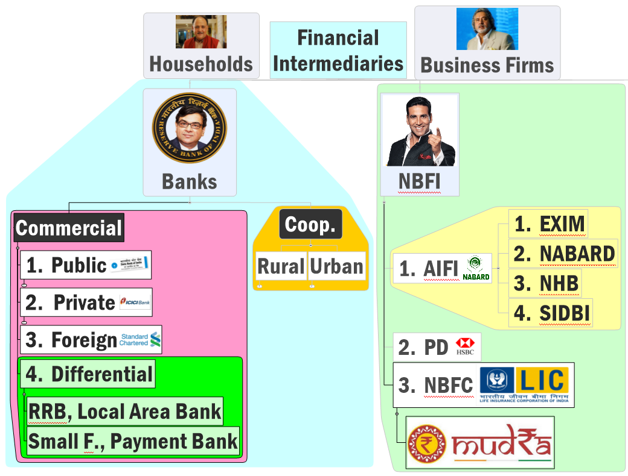
Where should I plot Wholesale Bank?
Universal Commercial Banks

Slide 7



Differential Banks
Small F.Banks
Payment Banks
Wholesale Banks
Custodian Banks
2015: Finished Selection
Covered in this lecture link
2016: Apr. Monetary Policy suggested
RBI’s Nachiket Mor Committee on Financial inclusion (2014) Suggested Differential Banks /Niche banking

Slide 8

Custodian Bank
Differential Banks
Clear guidelines, functions yet to be announced by RBI
Safekeeping of securities, derivatives, MF, metals, commodities, foreign currency etc.
Keep client informed about yield, AGM etc.
Execute deals for client

Slide 9



Slide 10
Cooperative earlier “state registrar of cooperatives”
Banking Reg. Act
CRR, SLR
MSF, PSL
Who can borrow
Vote power
Presence
Yes’ 49
Yes ‘66
Yes
Yes
Yes
Nope
Anyone
Only members
Shareholding
1p1v
All India, Abroad
Guj,MH,Andhra,TN
Type
Commercial
Cooperative
Profit Motive
Yes
No
Notes:
State registrar

Slide 11
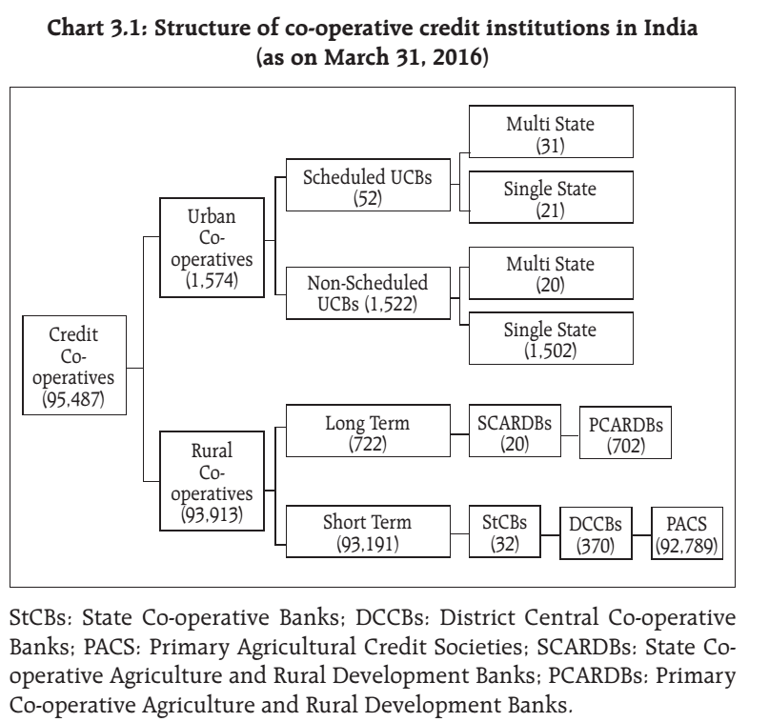


Land development banks…long term

Slide 12
“RURAL” Cooperative Banks Hierarchy
Parked in State Bonds
(SLR/ above)
State
Balancing
District Central
PACS
Surplus from 1 central to another
borrow 10x times share provided to central
Lend to district
Can’t exchange SBN (500-1000) in Maharashtra, Kerala, TN, Guj after 6th day of Demonetization
NABARD Lending
Surplus Funds

Slide 13
Mock Qs.
(A)State Governments are net debtors to cooperative banks
(R). Cooperative banks park their surplus funds into bonds of state governments
Both right, R explains A

Slide 14
UPSC Prelims-2003
Which of the following grant(s) direct credit assistance to rural households?
RRB
NABARD
Land development Banks
Choice:
Only 1 and 2
Only 2.
Only 1 and 3
1, 2 and 3.

Slide 15

Rural cooperatives ~25% (Rs.15 billion) NPA @PACS (2015)
challenges
Can lend to only members…1p1v=> Casteism/majoritarinism
SARFAESI powers given (on non-agri loans) but not used. Political backing to defaulters.
Panchmahal District Cooperatives Bank (BJP): 185 Cr; Visnagar bank (Congi): 450 cr
Rich farmers themselves become money lenders from borrowed money!
Deposits are very low, because rates not competitive against SCB, post offices.
Solution
Close down PACS->LAMPS: large sized multi-purpose society. Taken in DPAP (Drought Prone Areas Programme)
etc. but did not improve much, due to vested interest.
ग्रामीण सहकारी बेंको की बदहाली के लिए,
बचू यादव जैसे लोग जिम्मेदार है.
Notes:
Drought Prone Areas Programme (DPAP)

Slide 16
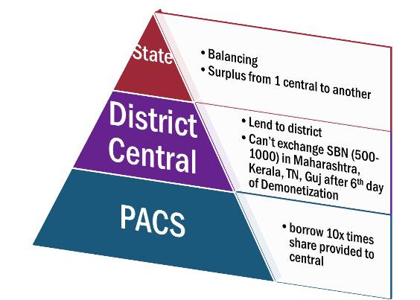
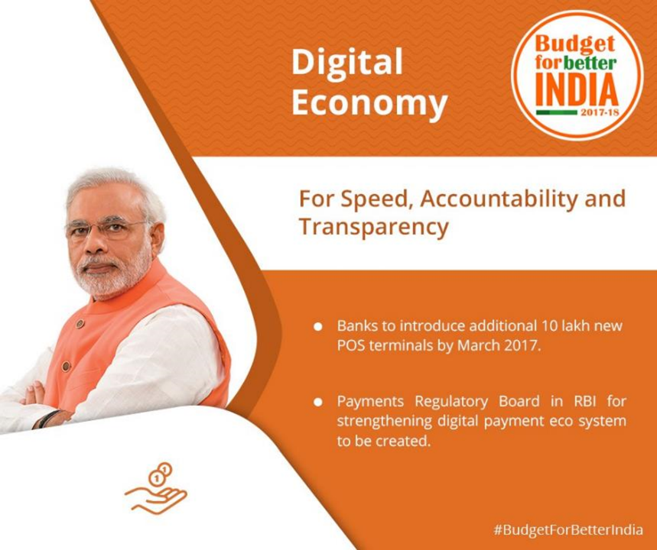

Core Banking Solution (CBS)
PACS-> DCCB.
NABARD given ~1900 cr and 3 years deadline
JDY- Aadhar seeding: Monitoring of of Agri credit, MUDRA loans, money laundering …

Slide 17
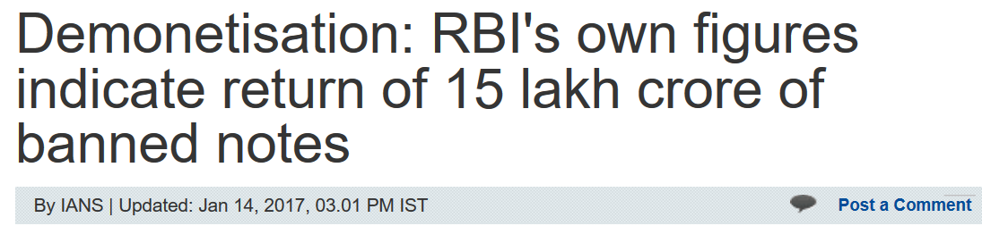

News after two months!!
One of the many tactics used to deposit black money in old notes ..
Back Dated “Fixed Deposits” in Cooperative Banks
Because manual account keeping, not core banking solution (CBS) software.
SBN: total 15 lakh cr.
97% returned to system!
Rs.54,000 cr black money destroyed
Notes:
http://economictimes.indiatimes.com/news/economy/finance/recall-could-cost-a-massive-rs-1-28-lakh-crore-says-cmie/articleshow/55608552.cms

Slide 18
Mock Question for Prelims
In Budget 2017, NABARD is given funds to setup Core Banking Solution Network (CBS) between..
Cooperative banks & Regional Rural Banks (RRB)
Cooperative banks & Public Sector Banks (PSB)
Rural cooperative and urban cooperatives
Village cooperative credit societies & District cooperative banks.

Slide 19
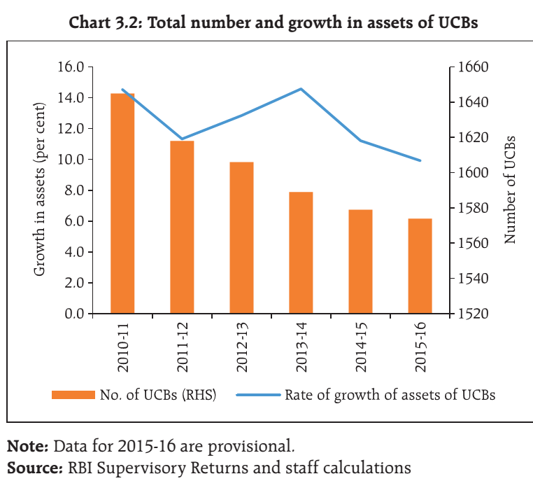
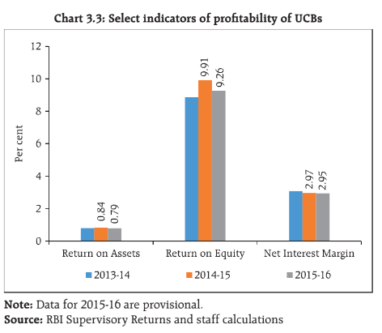
Rural cooperatives are bogus but urban also bogus….WHY?
2016: RBI’s Institute for Development and Research in Banking Technology
(IDRBT), to provide financial assistance and
technology support for implementation of CBS in UCBs.

Slide 20

Urban cooperatives
problems
builders, friends, relatives
SARFAESI Act'02: powers given to Cooperative Banks (2003) but recovery dismal.
Madhupura Mercantile Cooperative Bank (Ketan Parekh Scam'01): 1700 cr. License cancelled in 2012
multi-state cooperative, the matter will rest with the central registrar of the cooperatives [Agri. Ministry]
Guj: Before >36 now hardly 18 left.
शहरी सहकारी बेंको की बदहाली के लिए,
केतन पारेख जैसे लोग जिम्मेदार है.

Slide 21
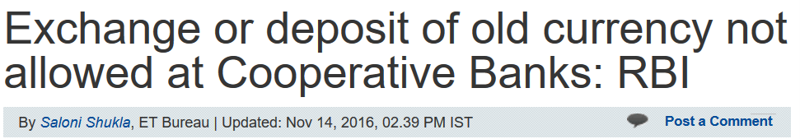
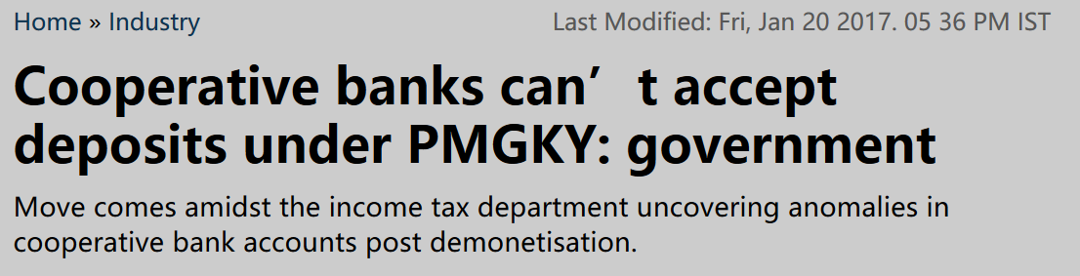
Mal-practices= SBN / Garib Kalyan Yojana….x
More under the BES17 “2”-> Black Money lecture
Notes:
After junking old Rs500 and Rs1,000 notes, the Centre had come up with an amnesty scheme for holders of unaccounted cash by asking them to pay 50% tax and parking one-fourth of it in a no-interest bearing four-year deposit. This deposit could be made with any banks. But now cooperative banks have been barred from accepting such deposits. The PMGKY scheme is open till 31 March.
Application for the deposit in the form of bonds ledger account shall be received by any banking company, other than cooperative banks, to which the Banking Regulation Act, 1949, applies,” the government said while amending the notification for PMGKY, 2016.

Slide 22

Birth, Structure
Functions, powers
Evolution,
Nationalization,
Consolidation”
PROBLEMS, CBS
3 rounds.
“on-tap” license
LENDING & GEOGRAPHICAL OP.
IPPB

Slide 23

DFI: @international level - World Bank group
Commercial Banks
Capital Market
AIFI / DFI
Till 90s malpractices, penetration
Controls on FDI/FII…
Long term fin…x esp. post nationalization
Retail loans, PSL, Kisan, artisans,
Investors limited
Med / long term finance to industries
Not mere loans but also support services e.g. arranging forex, underwriting, technical / mgmt advice, Bank guarantee etc.
Don’t accept demand DEPOSIT from ordinary people (CASA…x)
Notes:
Imf also?

Slide 24
Post independence DFI
IFCI’48 ACT
SFI’51 ACT
Industrial finance corporation of India ltd.
State finance corporation Act since IFCI alone couldn’t cater.
NSIC’55 Govt owned
National small industries corporation
ICICI’55
Because above 3 forbidden from underwriting, share market investment.
Industrial credit and investment Corporation of India Ltd
By GoI, World Bank, and other FI.
IDBI’64 Act
Industrial development bank of India( IDBI)’
1970s: IFCI becomes subsidiary of IDBI, and
IDBI becomes regulatory body for industrial finance->SIDBI, EXIM..functions given

Slide 25
Post independence DFI
States 60s
State industrial development Corporation (SIDC)
State small industries development Corporations (SSIDC)
Others
Apart from them LIC (56), UTI-MF (64), GIC (73) also played role.

Slide 26

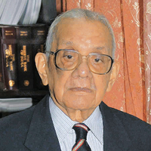
BEFORE Narsimhan-1 (1991)
MSME: Administered interest rate-> NPA/loss
Industrialist: Suitcase raj-> licenses-> greenfield project -> NPA
G-sec->DFI
Eligible under SLR
High SLR [40%]
DFI issue bonds
How will DFI arrange money?
Notes:
Industrialists, MSME given cheap loans under “administered” rate, but NPA high as “greenfield” projects sanctions without due diligence

Slide 27
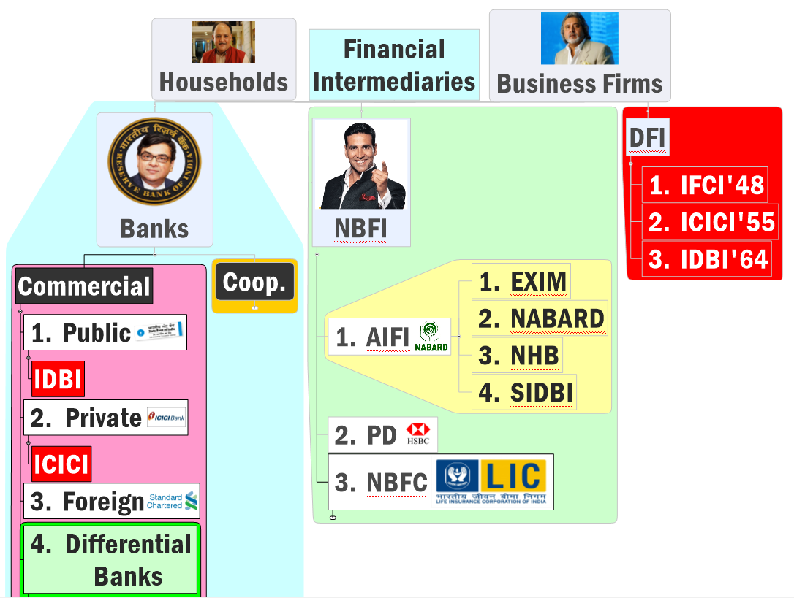
Narsimhan-I (‘91): New bank license…
to increase competition
1993-94 process [6+4]

Slide 28
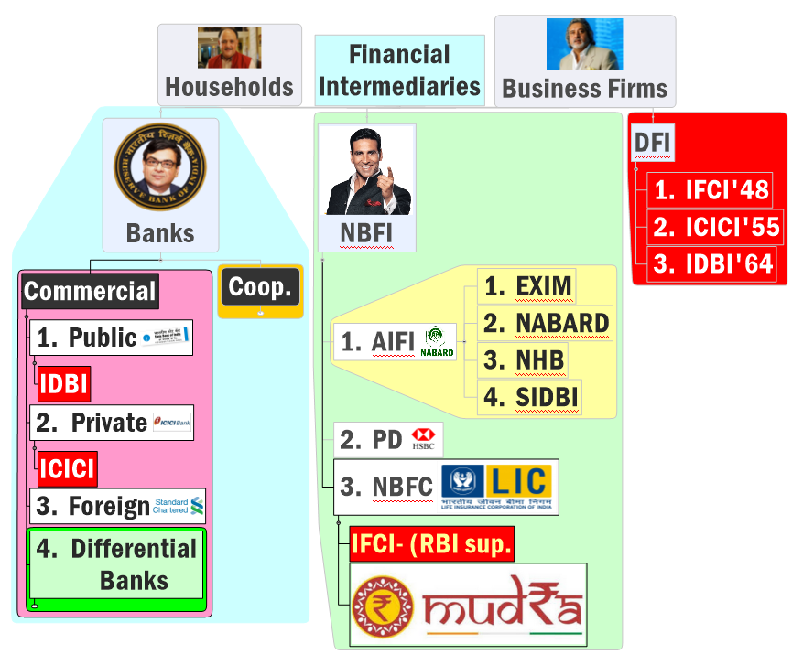

Though DFIs are closed down, but RBI feels separate ‘wholesale (big)’ banks should be there to finance infra
Can’t blame Narsimhan for the lack of foresight though, because his ‘times’ were different (”not-TBS”)
Narsimhan-II (‘98): only two category: Bank or non-bank.
NO DFI…regulatory issues
NBFC-ND-SI
Nondep. Taking but >500 cr.

Slide 29

Four All India financial institutions (AIFI): Chronology wise
1) EXIM: 1 / Jan / 1982
Export-Import Bank of India
2) NABARD: 12 / July / 1982
National Bank for Agriculture and Rural Development
loan/credit/finance to exporters and importers.
promotes cross border trade and investment
Boss: Government of India (100%)
BOSS: GoI (99.3%) + RBI (0.7%)
Rural infra. Development fund (RIFD) if PSL not met (Lecture link) Indirect refinance to farmers, artisans.
Regulatory authority: Coop + RRB

Slide 30
Although under Banking Regulation Act, RBI is the ‘ultimate’ authority
क्योकि टुच्ची Cooperatives and RRB का सूपरविजन करने से ज्यादा हमको और भी जरूरी काम होते है. hence surveillance delegated to NABARD.

Slide 31
Mock Question for UPSC prelims
Find correct statements about cooperative banks in India:
Banking Regulation Act doesn’t apply to them
Priority Sector Lending norms don’t apply to them.
NABARD is their immediate regulator and RBI is their ultimate regulator.
Answer Choices
a) Only 1 and 2 (b) Only 2 and 3
c) Only 1 and 3 (d) All of them

Slide 32
Four AIFI: Chronology wise 1) EXIM done 2) NABARD done
#3: National Housing Bank [88, July]
Boss: RBI (100%)
apex institution for housing finance in India
Finance to banks and NBFCs for housing projects
RESIDEX index (housing sector-inflation)
#4: SIDBI [1990, April]
Small industries development bank of India
BOSS: SBI, LIC, IDBI other public sector banks, insurance companies etc.
SIDBI's SEDF= small enterprises development fund. (Foreign banks will <20 branches, !PSL)
Budget 2017: Rs.20k crore for cheap housing loans
5th Industrial Investment Bank of India (IIBI)…closed in 2012
North Eastern….X (AIFI not in annual reports of RBI)

Slide 33
2007 Prelims
The national housing bank (NHB) was setup in India as a wholly owned subsidiary of which of the following bank?
State bank of India
Reserve Bank of India
ICICI
LIC

Slide 34
2004 Prelims
Find Correct Statement(s)
(RIGHT) NHB, the apex institution of housing finance in India, was setup as a wholly owned subsidiary of RBI
(WRONG) Small industries development bank of India was established as a wholly owned subsidiary of the Industrial development bank of India
Both A and B
Neither A nor B

Slide 35

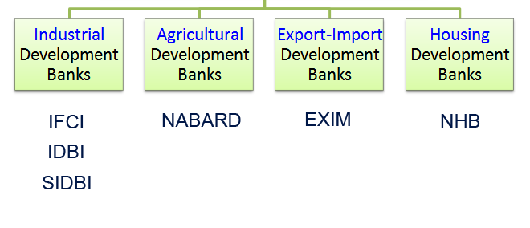
Developmental financial institutions (DFI)/developmental banks
Narsimhan-II (‘98): only two category: Bank or non-bank.
NO DFI…regulatory issues

Slide 36


